Slide 1
Module 5 - Navigation & State Management in Flutter

Slide 2
Contents
Understand how Flutter manages navigation between screens.
Learn both Navigator 1.0 (imperative) and Navigator 2.0 (declarative).
Explore state management with setState, InheritedWidget, and Provider.
Build a multi-screen app that handles state transitions correctly.
Notes:
Introduce how navigation and state interact. Mention that this module links UI logic (Module 4) with data flow and routing.

Slide 3
What is Navigation?
The Navigator widget has an array of pages. A Page is an abstract class that has a name and argument.
Navigation in Flutter controls movement between screens (routes).
Each new page is pushed onto a stack, and when you go back, the top page is popped off. There are a few important methods, as follows:
push(context, route): Push a new route/page to the stack.
pushNamed(context, routeName, arguments): Find the route with the given name and push it onto the stack.
pop(context): Pop the current, top-level page off the stack, showing the next page on the stack

Slide 4
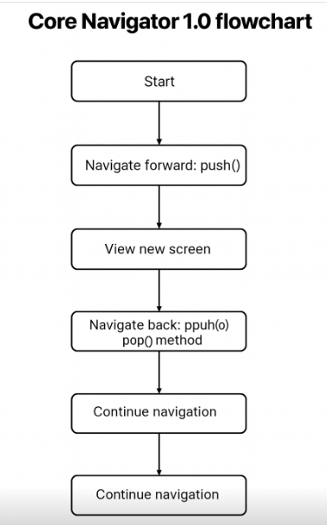
Navigator 1.0 Flow
Core Navigator 1.0 flowchart
Start: App begins at the initial screen.
push(): Navigate to a new screen; it is added to the top of the stack.
View screen: User sees the new screen; the stack grows by one layer.
pop(): Return to the previous screen; the top screen is removed.
Repeat: Continue navigating forward (push) and backward (pop).ving it from the stack
Notes:
Navigator 1.0 uses an imperative approach, you tell Flutter when and how to navigate.

Slide 5
Routes in Flutter
A Route is a screen or page inside an app. MaterialPageRoute is a common implementation.
Code example
Navigator.push(
context,
MaterialPageRoute(builder: (context) => ProfilePage()),
);
Note: The widget returned by builder defines the next screen’s UI.

Slide 6
Navigator Class
Core Methods:
Method | Purpose
push() | Adds a new route
pop() | Removes the current route
pushReplacement() | Replaces current route
pushNamed() | Navigate by route name
maybePop() | Conditionally pop a route
Example:
Navigator.pushReplacementNamed(context, '/home');
Notes:
Explain that each route represents a state of the app’s UI tree.

Slide 7
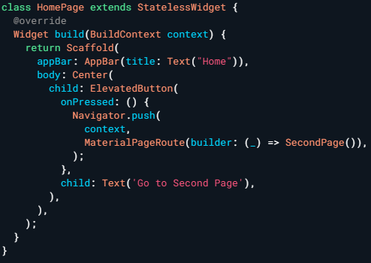
Example: Basic Navigation
Explanation of why the original code does not run in DartPad
Notes:
Explanation of why the original code does not run in DartPad
1️⃣ DartPad requires complete program
– must have main()
– must have runApp()
– must have native MaterialApp widget
2️⃣ SecondPage() is not defined → compile error
3️⃣ DartPad Flutter mode does not build scaffold automatically if only 1 widget is provided
→ Therefore, HomePage and SecondPage must be placed in the full structure.

Slide 8
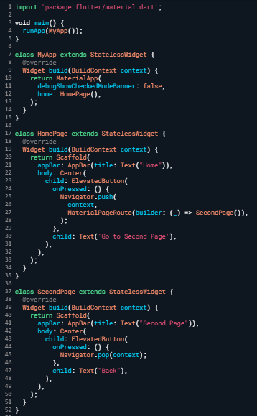
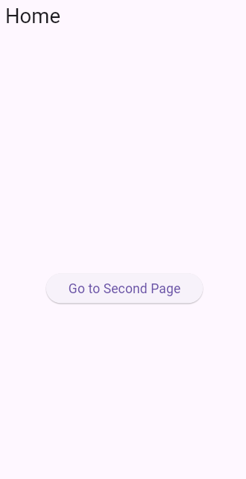

Example: Basic Navigation
Notes:
Code demo Dartpad:
import 'package:flutter/material.dart';
void main() {
runApp(MyApp());
}
class MyApp extends StatelessWidget {
@override
Widget build(BuildContext context) {
return MaterialApp(
debugShowCheckedModeBanner: false,
home: HomePage(),
);
}
}
class HomePage extends StatelessWidget {
@override
Widget build(BuildContext context) {
return Scaffold(
appBar: AppBar(title: Text("Home")),
body: Center(
child: ElevatedButton(
onPressed: () {
Navigator.push(
context,
MaterialPageRoute(builder: (_) => SecondPage()),
);
},
child: Text('Go to Second Page'),
),
),
);
}
}
class SecondPage extends StatelessWidget {
@override
Widget build(BuildContext context) {
return Scaffold(
appBar: AppBar(title: Text("Second Page")),
body: Center(
child: ElevatedButton(
onPressed: () {
Navigator.pop(context);
},
child: Text("Back"),
),
),
);
}
}

Slide 9
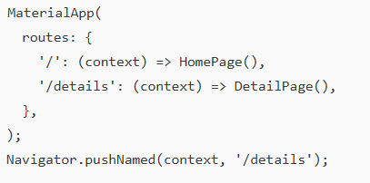
Named Routes
Concept: Named routes simplify app navigation by creating a map of names to screens. Structure (template)
Code Example:
Notes:
Explain how this improves readability and scalability. Useful for large apps or when passing arguments between screens.

Slide 10
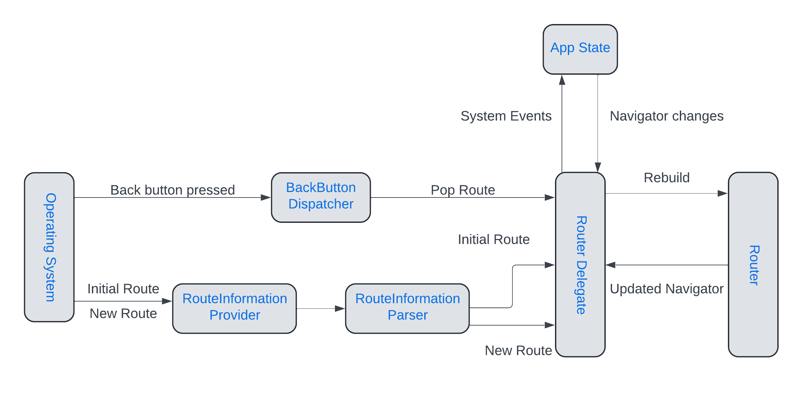
Navigator 2.0 Architecture
Concept: Navigator 2.0 introduces a declarative model.
Instead of calling push() and pop() manually, you describe the desired stack.
Notes:
Explain how Flutter aligns with web-style navigation and deep links.
Main Components:
RouterDelegate
RouteInformationParser
BackButtonDispatcher

Slide 11
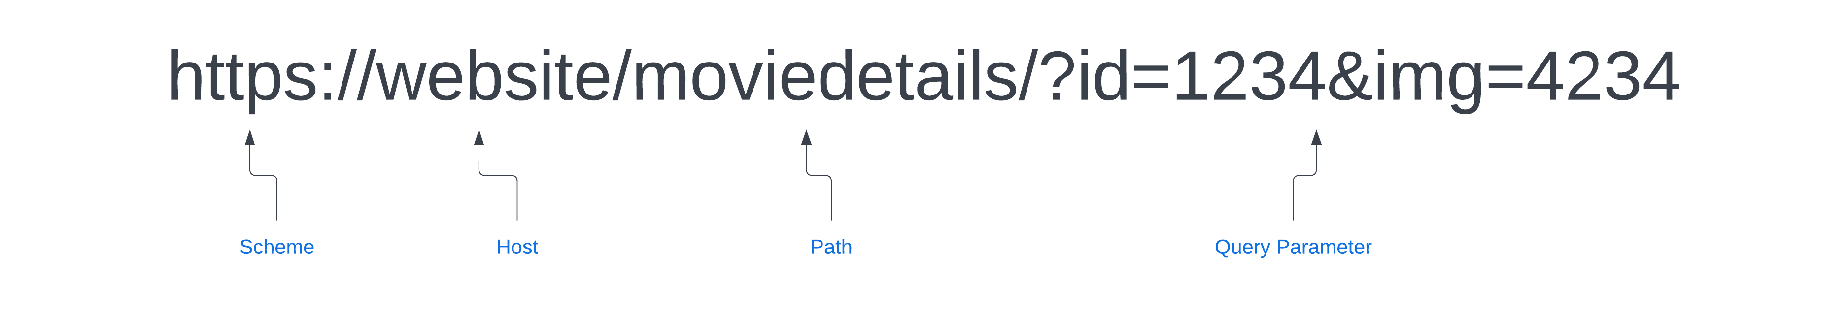
Deep Linking Overview
Concept: Deep linking allows users to open a specific screen via a URL or external source.
Example URL

Slide 12
Setting Up Android Deep Links
Step 1: Modify AndroidManifest.
<intent-filter>
<action android:name="android.intent.action.VIEW" />
<category android:name="android.intent.category.DEFAULT" />
<category android:name="android.intent.category.BROWSABLE" />
<data android:scheme="movieapps" android:host="movies" />
</intent-filter>
Step 2: Add a test link in browser or terminal
adb shell am start -a android.intent.action.VIEW -d"movieapps://movies?id=12"
Notes:
Explain how Android uses intent filters to handle deep link routing.

Slide 13
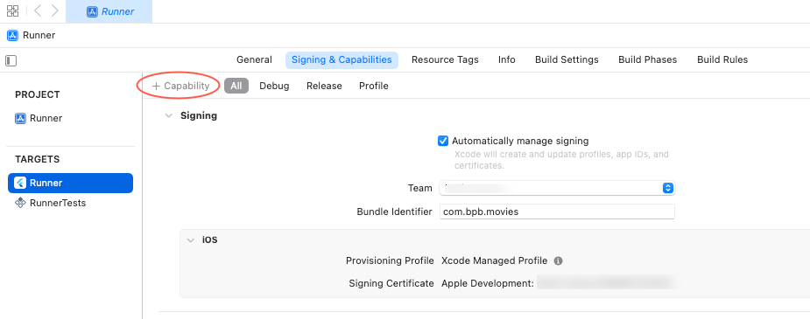
Setting Up iOS Deep Links (Part 1)
Concept: Enable Associated Domains capability inside Xcode.
Steps: 1️⃣ Open project → select Runner target
2️⃣ Open Signing & Capabilities tab
3️⃣ Click + Capability → select Associated Domains

Slide 14
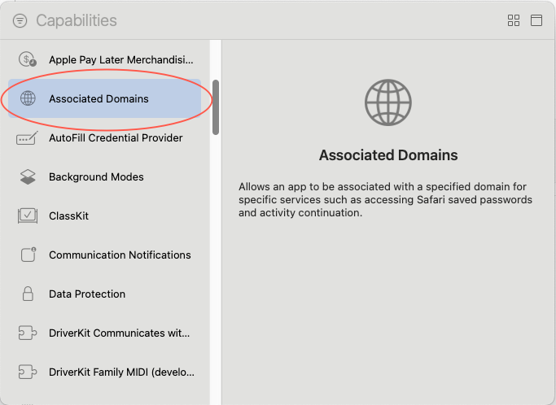
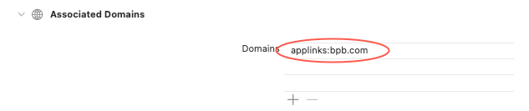
Setting Up iOS Deep Links (Part 2)
Steps continued:
4️⃣ Add domain entry:
applinks:movieapps.com
Notes:
Remind students to ensure the domain’s AASA file is hosted at /.well-known/apple-app-site-association.

Slide 15
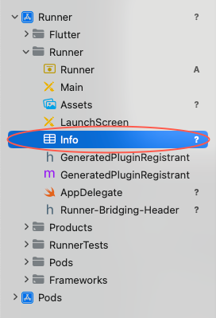
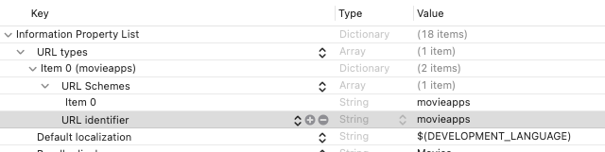
Editing Info.plist
Concept: Add URL Types to Info.plist to define the custom scheme.
Steps: Navigate to Runner/Info.plist
Add a new entry: URL Types → URL Schemes → movieapps
Notes:
Clarify the difference between app scheme and associated domain.

Slide 16
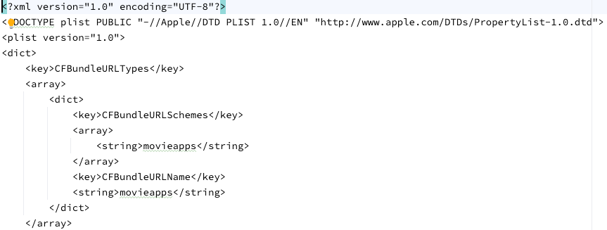
Info.plist XML Example
Show how this snippet connects to the scheme movieapps://movies?id=1.

Slide 17
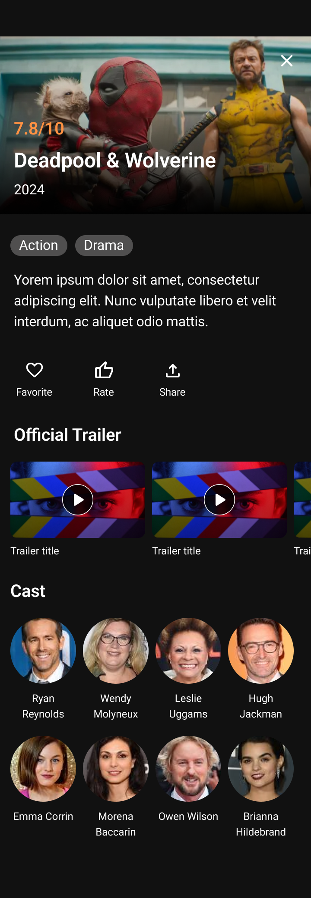
Demo Start: Blank Scaffold
Goal: Start MovieDetailPage with a blank scaffold.
Content:
class MovieDetailPage extends StatelessWidget {
@override
Widget build(BuildContext context) {
return Scaffold(
appBar: AppBar(title: Text("Movie Detail")),
body: Center(child: Text("Coming soon...")),
);
}
}
Notes:
Explanation: Establishes the screen structure before adding UI elements.

Slide 18
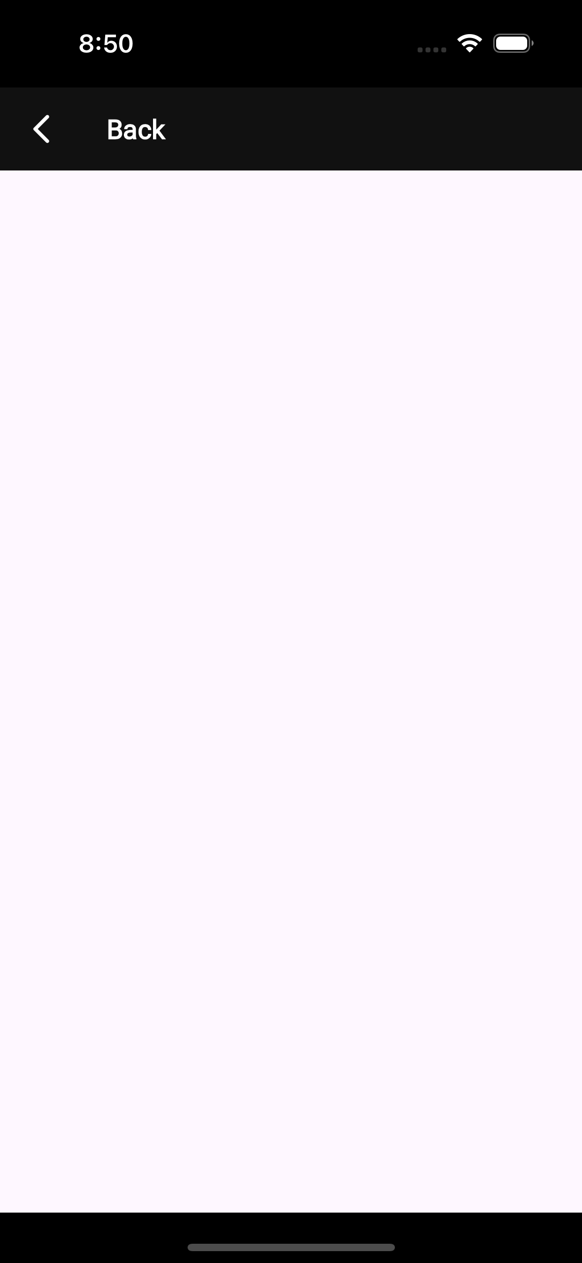
Step 1: Add Hero Banner
Goal: Add movie poster with gradient overlay.
Content:
Stack(
children: [
Image.network(movie.posterUrl, fit: BoxFit.cover),
Positioned(bottom: 0, child: Container(height: 80, decoration: gradient)),
],
)
Notes:
xplanation: The Stack widget allows the image and overlay to overlap.

Slide 19
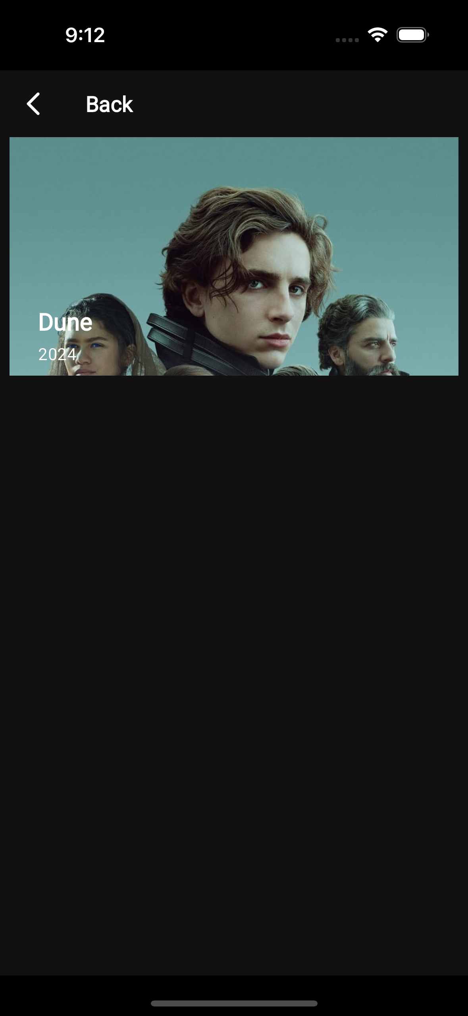
Step 2: Add Title & Genres
Goal: Add movie title and genre chips.
Content:
Column(
crossAxisAlignment: CrossAxisAlignment.start,
children: [
Text(movie.title, style: TextStyle(fontSize: 22, fontWeight: FontWeight.bold)),
Wrap(spacing: 6, children: movie.genres.map((g) => Chip(label: Text(g))).toList()),
],
)
Notes:
Explanation: Wrap handles chip wrapping to new lines.

Slide 20
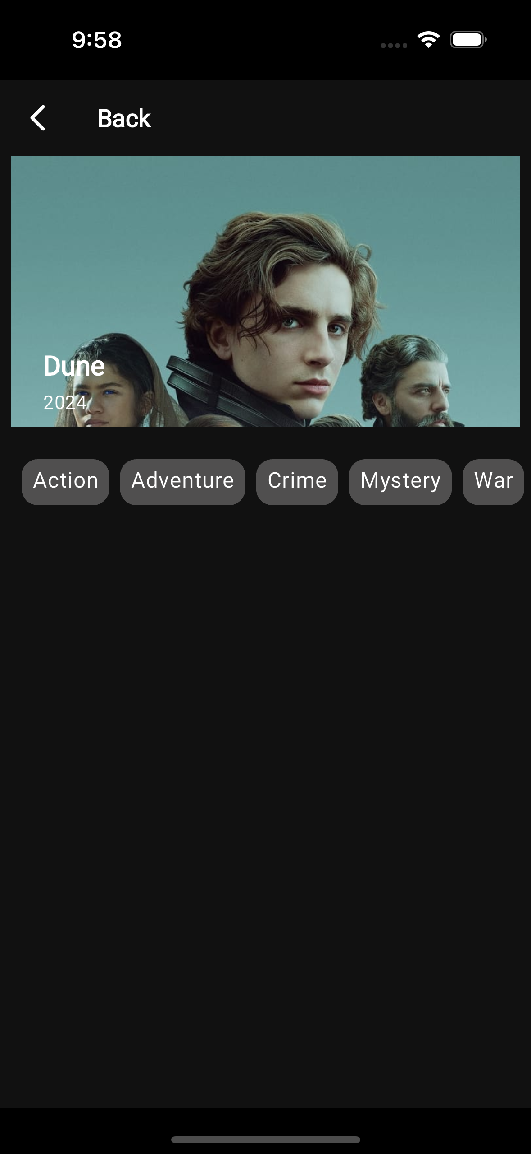
Step 3: Add Overview Text
Goal: Add movie description text.
Content:
Padding(
padding: const EdgeInsets.all(12.0),
child: Text(movie.overview, style: TextStyle(fontSize: 16)),
)
Notes:
Explanation: Padding improves readability; scrollable if text is long.

Slide 21
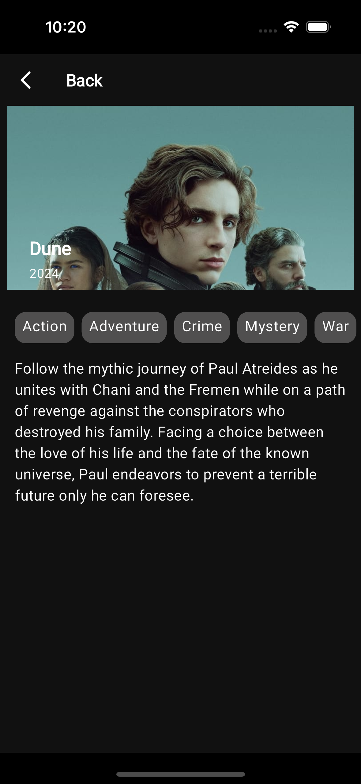
Step 4: Add Action Buttons
Goal: Add “Favorite”, “Rate”, and “Share” icons.
Content:
Row(
mainAxisAlignment: MainAxisAlignment.spaceEvenly,
children: [
IconButton(icon: Icon(Icons.favorite), onPressed: () {}),
IconButton(icon: Icon(Icons.star_rate), onPressed: () {}),
IconButton(icon: Icon(Icons.share), onPressed: () {}),
],
)
Notes:
Explanation: Row distributes buttons evenly with consistent alignment.

Slide 22
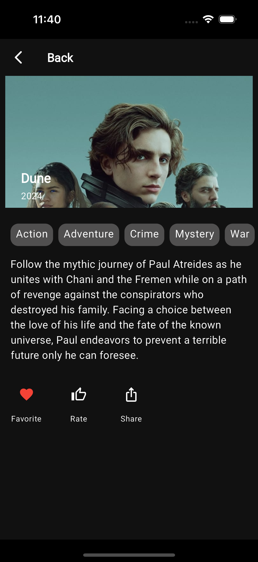
Step 5: Add Trailer List
Goal: Display list of trailers below description..
Content:
ListView.builder(
itemCount: movie.trailers.length,
itemBuilder: (_, i) => ListTile(
leading: Icon(Icons.play_circle_fill),
title: Text(movie.trailers[i].title),
),
)
Notes:
Explanation: ListView.builder is used for dynamic lists.

Slide 23
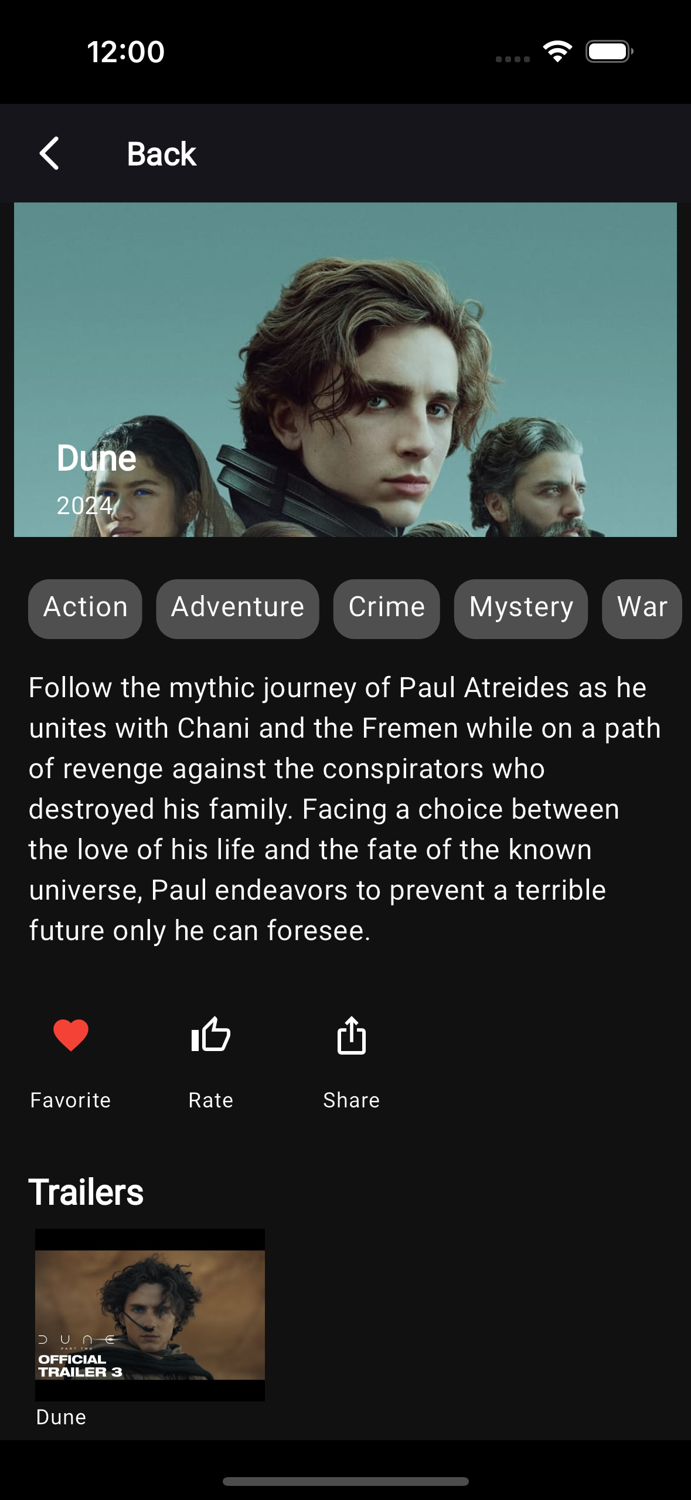
Step 6: Final Layout: Complete Detail Screen
Goal: Combine all widgets for the final view
Notes:
Explanation: Demonstrates how multiple Flutter widgets compose a polished screen with responsive scrolling.

Slide 24
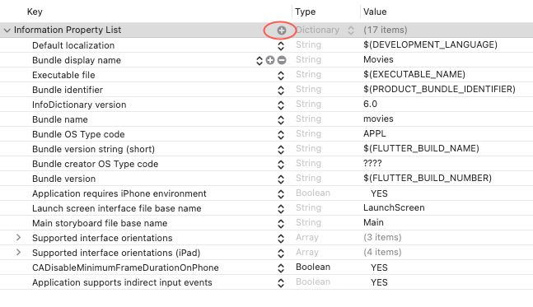
Implementing Route Handling
Concept: Handle incoming deep links via onGenerateRoute.

Slide 25
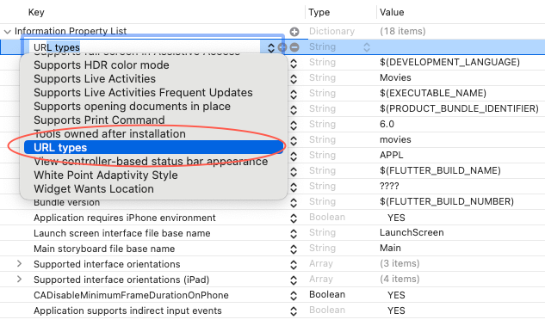
Navigator 2.0 with State Integration
Concept: Navigator 2.0 works with state objects to react to URL changes.
Notes:
class AppRouterDelegate extends RouterDelegate<AppRoute>
with ChangeNotifier, PopNavigatorRouterDelegateMixin<AppRoute> {
@override
Widget build(BuildContext context) {
return Navigator(
pages: [MaterialPage(child: HomePage())],
onPopPage: (route, result) => route.didPop(result),
);
}
}

Slide 26
Managing App State
Concept: State determines what the user sees. Managing it properly keeps the UI consistent.
Example:
Note: Explain why state is separated from UI (architecture clarity, testability).
class AppState extends ChangeNotifier {
bool loggedIn = false;
void login() { loggedIn = true; notifyListeners(); }
}

Slide 27
Stateless vs Stateful Widgets
Comparison Table:
Note: Highlight that Stateful widgets use setState() to trigger rebuilds.
Type | Rebuilds on Change | Example Use
StatelessWidget | No | Static UI – Logo, Text
StatefulWidget | Yes | Interactive UI – Form, Counter

Slide 28
setState() Usage - Lifting State Up
Example: setState() Usage
class CounterPage extends StatefulWidget { ... }
setState(() {
count++;
});
Concept: Lifting State Up Share state between child widgets by moving the state to a common ancestor.
class ParentWidget extends StatefulWidget {
@override
_ParentWidgetState createState() => _ParentWidgetState();
}
Notes:
Mention the lifecycle methods (initState, dispose) and why setState is only valid inside State objects.
Lifting State Up: Explain how this reduces duplicate logic and improves data flow control.

Slide 29
InheritedWidget
Pass data down the widget tree efficiently.
Code Example:
class AppData extends InheritedWidget {
final String theme;
const AppData({required this.theme, required Widget child, Key? key})
: super(key: key, child: child);
static AppData of(BuildContext context) =>
context.dependOnInheritedWidgetOfExactType<AppData>()!;
}
Notes:
Point out how Flutter’s widget tree is reactive when data changes.

Slide 30
Provider
Provider Overview
Provider simplifies state sharing and listening to changes.
Provider Example
ChangeNotifierProvider(
create: (_) => CounterModel(),
child: CounterPage(),
);
class CounterModel with ChangeNotifier {
int count = 0;
void increment() { count++; notifyListeners(); }
}
Consumer<CounterModel>(
builder: (_, counter, __) =>
Text('${counter.count}'),
);
Notes:
Mention that Provider is built on InheritedWidget but with less boilerplate.
Show live counter update in DartPad. Highlight how Provider notifies listeners automatically.

Slide 31
Combining Navigation & State
Integrate state with routing logic.
if (appState.loggedIn)
Navigator.pushNamed(context, '/dashboard');
else
Navigator.pushNamed(context, '/login');
Notes:
Use this slide to connect authentication flow with state logic.

Slide 32
Practice Task
Task
Build a small “Movie App” with:
Deep link opening movie detail page
Provider for favorite movies state
Working back button navigation

Slide 33
Summary
Navigator 1.0 vs 2.0 architecture
Deep link setup on Android & iOS
State management patterns: setState, InheritedWidget, Provider
Integration of navigation and state

Slide 34
References
Mastering Flutter 2025 – Ch.6, Ch.8
docs.flutter.dev
https://dartpad.dev

